Slide 1


I2P-2
12306
beat the monster

Slide 2

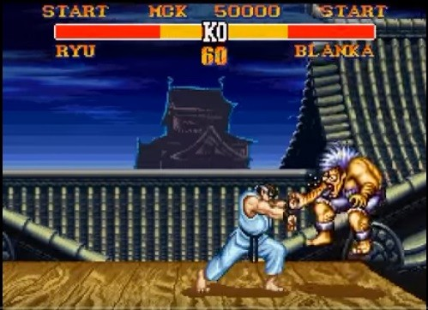


You are playing a game.
The goal of this game is to kill the monster when you are still alive (HP > 0, where HP = health point).
The monster is dead if and only if its HP <= 0.
Description

Slide 3
Description
This game consists of rounds, and you go first in each round. In each round,
you have three options to do:
ATTACK. This will deduct the monster's HP. If your damage point is p, then you can deduct the monster's HP by p.
HEAL. You can recover some of your HP, but it can't exceed your max HP.
Level-up. Level-up might enhance or deduct the effect of attacking and healing. If you have reached max level, taking this action makes no effect.
the monster will attack you once with a fixed damage point.
You start the game with full HP and level 1. What is the minimun number of rounds you need to kill the monster?

Slide 4
Input
First line contains 4 numbers:
L = max level
HP = your max HP
MHP = monster's HP in the beginning of game
MDMG = monster's damage point
Each of the next L lines describes each level i. Each line i consists of two numbers:
DMG = your damage point when you use ATTACK at level i
HL = amount of HP you can recover when you use HEAL at level i
Input/Output
Output
Print a single integer, denoting the mininum number of steps you need to kill the monster.
If you are unable to beat the monster, print -1.

Slide 5
Input
3 10 5 2 (your max level, your max HP, monster HP, monster damage point)
1 1 (level 1 damage point, amount of heal)
2 2 (level 2 damage point, amount of heal)
3 3 (level 3 damage point, amount of heal)
Output
Example
4
Round | Your hp | Monster hp | Level
0 | 10 | 5 | 1
Round | Your hp | Monster hp | Level
0 | 10 | 5 | 1
1 | 8 | 5 | 2
2 | 6 | 3 | 2
3 | 4 | 1 | 2
4 | 2 | -1 | 2
Round | Your hp | Monster hp | Level
0 | 10 | 5 | 1
1 | 8 | 5 | 2
Round | Your hp | Monster hp | Level
0 | 10 | 5 | 1
1 | 8 | 5 | 2
2 | 6 | 3 | 2
Round | Your hp | Monster hp | Level
0 | 10 | 5 | 1
1 | 8 | 5 | 2
2 | 6 | 3 | 2
3 | 4 | 1 | 2
LV UP
ATK
ATK
ATK

Slide 6

Idea
Since level up may not be better all the time, so we can’t have a specific way to get the answer by doing something greedy (or heuristic).
So the best way is to try all possible permutations of doing attack / level up / heal.
And, since you want the minimum number of steps, you can use breadth-first search (BFS).
Let’s see another example with BFS.

Slide 7
BFS
1/5/8
Input:
2 5 8 2
2 4
3 0
LV UP
ATK
HEAL
2/3/8
1/3/6
1/3/8
LV UP
HEAL
ATK
…
LV UP
ATK
…
ATK
…
LV max
Cannot level up
x
2/1/5
2/1/6
1/1/4
1/3/6
1/1/6
…
…
HEAL
…
…
…
ATK
ATK
LV UP
ATK
ATK
2/-1/2
2/-1/3
2/-1/4
1/-1/2
1/3/4
1/1/4
Died
…
ATK
…
…
1/1/2
***State: Level / your hp / monster hp
Note also that, in each round, you go first!!!
Note the HEAL operation.
…
…
ATK
1/1/0
You win, since you attack first.

Slide 8
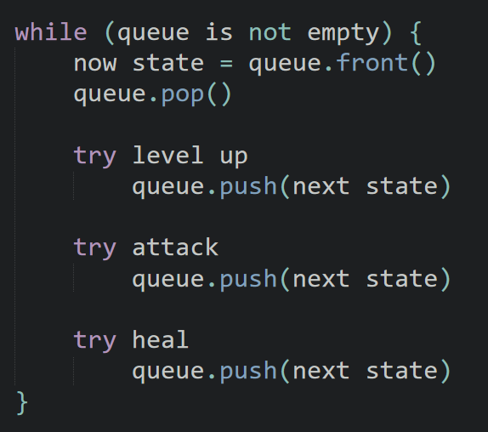
BFS
We can use a data structure: queue.

Slide 9
Optimize
However, if you simply use BFS to enumerate all permutations, you will probably get TLE.
Since there are too many ways of permutation.
So is there any way to optimize?

Slide 10
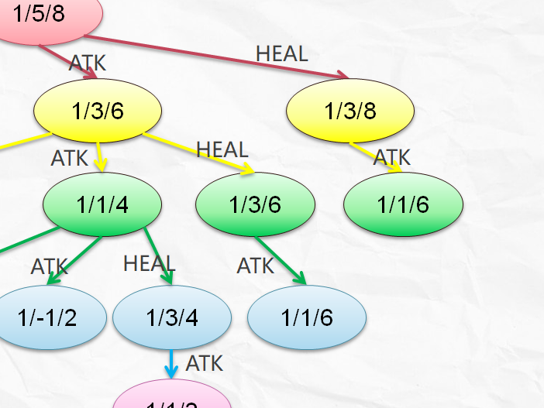
Optimize
Yes, as you can see, different permutations can arrive at a same state (狀態). You don’t really need a same state twice. We only need the shortest one.

Slide 11

Optimize
So you can simply use an array like this.
All with value false first.
vis[x][y][z] == false represents (level = x, hp = y, monster hp = z) has not been pushed into your queue yet.
vis[x][y][z] == true represents (level = x, hp = y, monster hp = z) has already been visited.

Slide 12
Data structures
struct State {
int lv, hp, mhp;
int dist;
State(int lv, int hp, int mhp, int dist = 0): lv(lv), hp(hp), mhp(mhp), dist(dist) {}
};
bool vis[20][310][410];
State
Rounds

Slide 13
The structure of main()
int main() {
//read the input
int lv, hp, mhp, mdmg;
int dmg[20], hl[20];
cin >> lv >> hp >> mhp >> mdmg;
for (int i = 1; i <= lv; i++)
cin >> dmg[i] >> hl[i];
queue<State> q;//the queue for BFS
q.push(State(1, hp, mhp));//the initial state
while (!q.empty()) {
State s = q.front();
if (!s.mhp)
break;
q.pop();
//Calculate the next states
// level up
???
// attack
???
// heal
???
}//end while
if (q.empty())
cout << -1 << endl;
else
cout << q.front().dist << endl;
return 0;
}

Slide 14
The next state when applying “level up”
You should avoid level over max level and avoid your hp going to negative value, or you might get Runtime Error since you put negative value in array.
if (s.lv < lv && s.hp - mdmg > 0) {
State t(s.lv + 1, s.hp - mdmg, s.mhp, s.dist + 1);
if (!vis[t.lv][t.hp][t.mhp]) {
vis[t.lv][t.hp][t.mhp] = true;
q.push(t);
}
}

Slide 15
The next state when applying “attack”
You should avoid your hp going to negative value, or you might get Runtime Error.
However, you need to attack the monster if the monster is confirmed to be dead, since you attack first.
if (s.hp - mdmg > 0 || s.mhp - dmg[s.lv] <= 0) {
State t(s.lv, s.hp - mdmg, max(0, s.mhp - dmg[s.lv]), s.dist + 1);
if (!vis[t.lv][t.hp][t.mhp]) {
vis[t.lv][t.hp][t.mhp] = true;
q.push(t);
}
}

Slide 16
The next state when applying “heal”
You should avoid your hp going to negative value, or you might get Runtime Error
if (hp > mdmg && hl[s.lv] > mdmg) {
State t(s.lv, min(hp, s.hp + hl[s.lv]) - mdmg, s.mhp, s.dist + 1);
if (!vis[t.lv][t.hp][t.mhp]) {
vis[t.lv][t.hp][t.mhp] = true;
q.push(t);
}
}

Slide 17
Time complexity
Note:
L <= 15
HP <= 300
MHP <= 400
So you will only have at most 15 * 300 * 400 different states, and each state will only be pushed into and popped from queue once.
And for each state, you only have 3 types of options to do.
That is, your amount of transitions (轉移數) is 3 for each state.
So your Time Complexity will be O(15 * 300 * 400 * 3).

Slide 18
Code:
https://gist.github.com/justin0u0/a639f7de49acb7ba9da12c3d7a92cf25

